Slide 1

Project Report: Building and Securing a Small Network
This project outlines the design, deployment, and management of a small network using Cisco platforms. The project focuses on building a functional and secure network with multiple VLANs, inter-VLAN communication, and robust security controls. The project is divided into four parts: network design and configuration, VLAN and inter-VLAN routing, network security implementation, and testing and reporting.

Slide 2


Part 1: Network Design and Configuration
The objective of this phase was to create a small-scale test network using Cisco devices. This involved defining the network topology, allocating IP addresses, and configuring network systems. The network was segmented using VLANs (VLAN 10: 10.0.0.0/24 and VLAN 20: 11.0.0.0/24) interconnected via multilayer switches and a Cisco ISR router for external connectivity.
VLAN 10
10.0.0.0/24 (e.g., PC0, PC2)
VLAN 20
11.0.0.0/24 (e.g., PC1, PC3)
Devices
Multilayer switches and Cisco ISR Router.

Slide 3
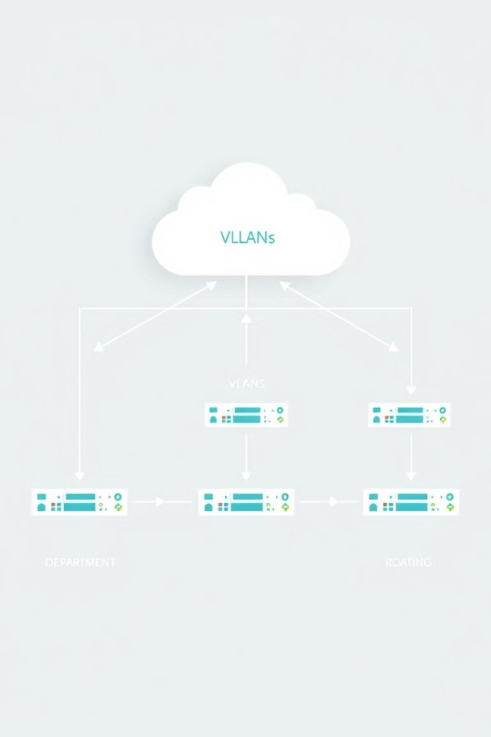
Part 2: VLANs and Inter-VLAN Routing
This phase focused on enabling communication between network segments. VLANs were implemented on switches, and trunk ports were configured for inter-VLAN communication. Inter-VLAN routing was established using multilayer switches as default gateways for their respective VLANs. Connectivity tests using ICMP pings confirmed successful communication between devices on different VLANs.
1
VLAN Implementation
VLANs created and trunk ports configured.
2
Inter-VLAN Routing
Multilayer switches configured as default gateways.
3
Testing
ICMP pings confirmed inter-VLAN communication.

Slide 4
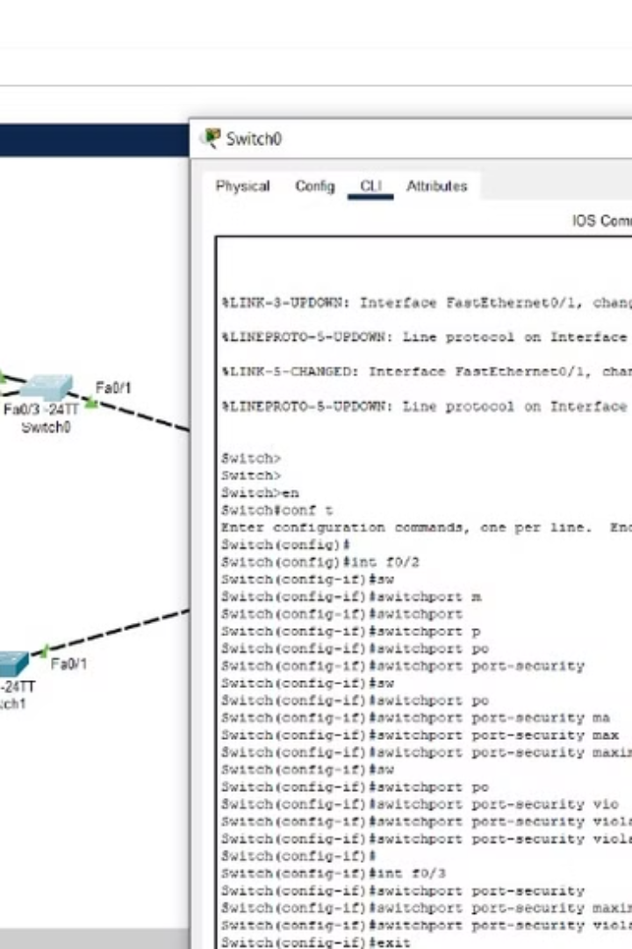
Part 3: Network Security Implementation
This phase involved implementing security measures to prevent unauthorized access. Port security was configured to limit the number of devices per switch port. Access Control Lists (ACLs) were implemented to manage traffic between VLANs, authorizing communication between specific devices. Basic firewall rules were configured on the router to control external access and internal traffic flow.
1
Port Security
Limited device connections per port.
2
ACLs
Controlled inter-VLAN traffic and authorized device communication.
3
Firewall Rules
Managed external access and internal traffic flow.

Slide 5
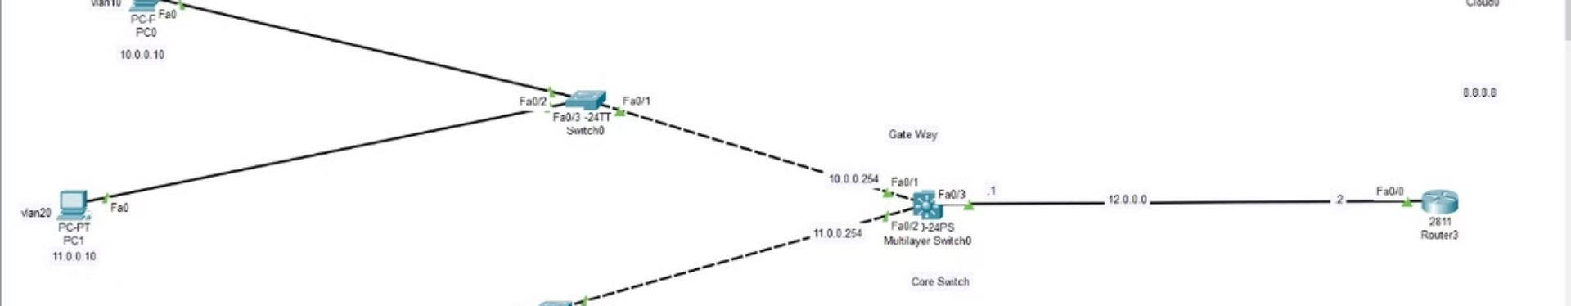
Initial Device Configuration
Initial device configuration included setting up VLANs on Cisco switches, assigning static IP addresses within each VLAN subnet, and configuring multilayer switches for inter-VLAN routing. This established the basic network infrastructure and communication pathways.
VLAN Setup
IP Addressing
Routing
VLAN 10 and VLAN 20 configured on switches.
Static IP addresses assigned within each VLAN subnet.
Multilayer switches configured for inter-VLAN routing.

Slide 6
Part 4: Testing and Reporting
The final phase focused on testing the network's functionality, security, and performance. Functional testing using ICMP pings verified inter-VLAN communication. Security testing involved attempts to connect unauthorized devices and bypass ACLs. Performance testing measured bandwidth, latency, and packet loss. A final report documented the network design, implementation, testing procedures, and results.
Functional Testing
Security Testing
Performance Testing
ICMP pings verified inter-VLAN communication.
Tested unauthorized device access and ACL bypass attempts.
Measured bandwidth, latency, and packet loss.

Slide 7
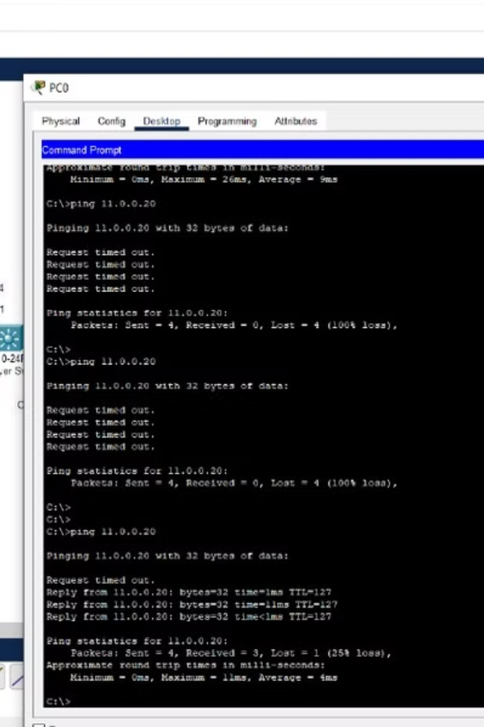
VLAN Configuration Details
VLAN 10 and VLAN 20 were created on the switches, and trunk ports were enabled to allow inter-VLAN communication. This segmentation ensured efficient traffic management and enhanced security by isolating broadcast domains.
1
VLAN Creation
VLAN 10 and VLAN 20 created.
2
Trunk Ports
Enabled on switches for inter-VLAN communication.

Slide 8
Security Features: Port Security
Port security was implemented to limit the number of devices allowed to connect to a specific switch port. This prevented unauthorized devices from gaining network access by simply plugging into an available port.
Port Security
Restricted the number of devices per port.

Slide 9
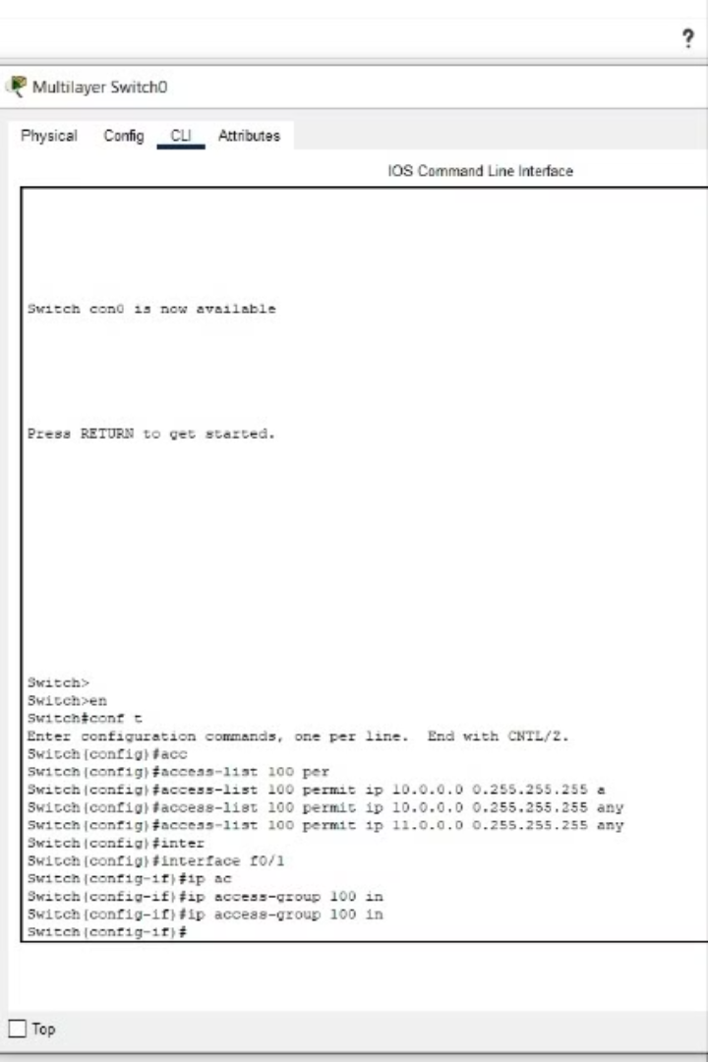
Security Features: Access Control Lists (ACLs)
ACLs were configured to manage traffic flow between VLANs and control communication between specific devices. This granular control enhanced security by restricting unauthorized access and preventing unwanted traffic from traversing the network.
ACL Configuration
Managed inter-VLAN traffic and device communication.

Slide 10
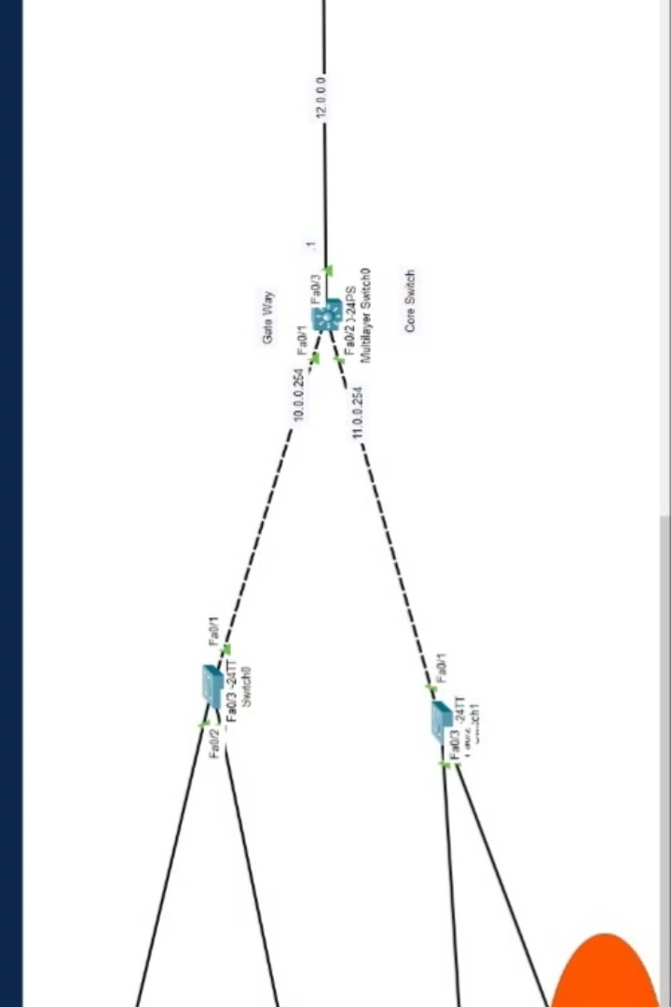
Conclusion and Project Outcomes
The project successfully created a secure and functional small network using Cisco equipment. VLANs, inter-VLAN routing, and security measures like port security and ACLs were implemented. Initial connectivity issues were resolved, resulting in a stable and efficient network that met project objectives.
1
Network Functionality
VLANs and inter-VLAN routing enabled successful communication.
2
Network Security
Port security and ACLs prevented unauthorized access.
3
Project Success
The network operates securely and efficiently, meeting project goals.

